Slide 1

Alzheimer’s Disease Classification
Using Machine Learning to Predict Early-Stage Alzheimer’s

Slide 2


Introduction to Alzheimer’s Disease
A Progressive Disorder: Neurological condition affecting memory, thinking, and behavior.
Impact: Severely disrupts daily life and cognitive function.
Importance of Timing: Early detection is critical to slowing disease progression.
The Role of ML: Machine learning offers tools to assist in automated, early diagnosis.

Slide 3
Problem Statement
Traditional diagnosis is often time-consuming, subjective, and costly.
Early symptoms are frequently ignored or misdiagnosed as normal aging.
There is a critical need for an automated, data-driven prediction system.
Main Goal: accurately predict Alzheimer’s using patient clinical data.

Slide 4
Project Objective
The primary aim is to develop a robust machine learning system.
Build: Develop an ML model to classify patient data.
Identify: Accurately distinguish between Alzheimer’s and non-Alzheimer’s cases.
Compare: Evaluate multiple algorithms (SVM, Random Forest, etc.).
Select: Deploy the highest performing model for prediction.

Slide 5
DATASET OVERVIEW
Analysis based on a dataset of 2,149 patients (ages 60–90).
Features include demographic details (Age, Gender) and clinical indicators.
Includes the crucial ‘Diagnosis’ target column.
Structured for Supervised Learning classification tasks.

Slide 6
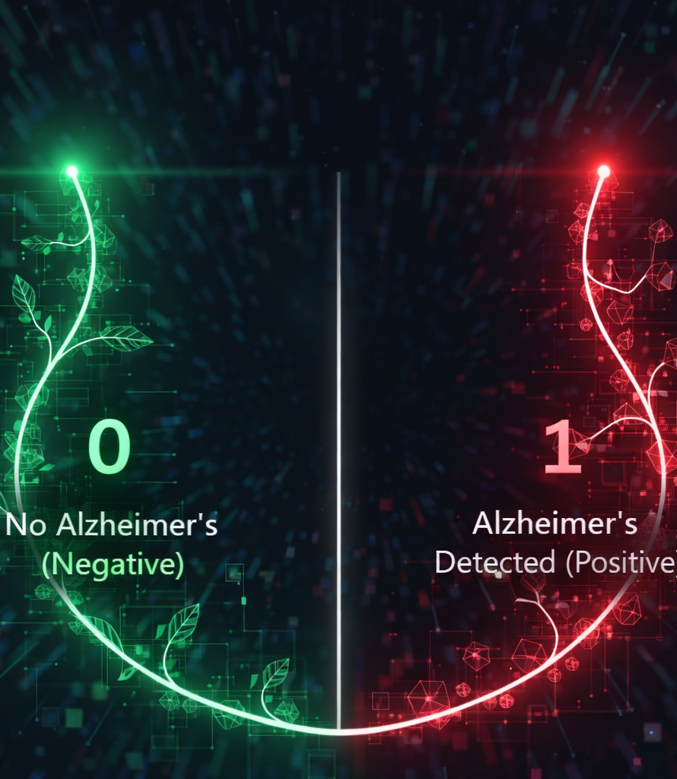
Target Variable: Diagnosis
This is a Binary Classification problem.
The model learns patterns to predict:
0: No Alzheimer’s (Negative)
1: Alzheimer’s Detected (Positive)

Slide 7
DATA PREPROCESSING
Cleaning: Removed irrelevant columns (IDs) and non-informative data.
Imputation: Checked and handled missing values to prevent errors.
Separation: Split dataset into Features (X) and Target (y).
Preparation: Formatted data structures for model intake.

Slide 8

Exploratory Data Analysis (EDA)
EDA allows us to unearth patterns before modeling:
Analyzed distributions of clinical features.
Checked Class Balance (Ratio of 0s to 1s).
Utilized visualization plots (histograms, heatmaps).Identified key trends and correlations.

Slide 9
Key Insights from EDA
Correlation: Specific features showed strong relationships with the diagnosis outcome.
Balance: Class distribution analysis indicated need for careful handling to avoid bias.
Range: Data required scaling as feature magnitudes varied significantly.
Integrity: No major data leakage was observed during the initial scan.

Slide 10
Feature Scaling Strategy
Standardization Used: Z-score scaling applied to features like Age, BMI, and MMSE scores.
Algorithm Specific: Crucial for Logistic Regression & SVM to prevent large-magnitude features from dominating.
Tree-Based Exemption: Random Forest and XGBoost used original values to preserve split interpretability.
Clinical & Demographic: Ensured diverse metrics (cognitive scores vs. blood pressure) are on the same scale.

Slide 11

Machine Learning Models
Logistic Regression
Decision Tree
Random Forest
XGBoost
Support Vector Machine (SVM)
LightGBM

Slide 12

Evaluation Metrics
Models were assessed using comprehensive statistical measures:
Accuracy Score: Overall correctness.
ROC-AUC Curve: Ability to distinguish between classes.
Classification Report: Precision, Recall, and F1-Score.
Overfitting Check: Comparing Train vs. Test performance.

Slide 13
Problems Faced
Determining the appropriate application of feature scaling.
Encountering overfitting in tree-based models.
Difficulty in selecting the single best model among many candidates.
Interpreting complex ROC-AUC results accurately.

Slide 14
Solutions Implemented
Selective Scaling: Applied scaling only for Logistic Regression and SVM where distance matters.
Ensemble Methods: Utilized Random Forest and Boosting to reduce overfitting.
Metric Focus: Prioritized ROC-AUC over simple accuracy for better class balance insights.
Final Selection: Chose the model with the most balanced performance characteristics.

Slide 15

Thank You!
Conclusion
Conclusion: Machine learning effectively predicts Alzheimer’s. LightGBM demonstrated the best performance, outperforming other models like SVM and Random Forest. Proper preprocessing was key to this success.

